Slide 1

Introduction to Python (week 2)
Louis Rey
UCSD Extension

Slide 2
Week 2 Objectives
Lists, and tuples, list methods
Strings, string methods
Basic Logic, Boolean concepts
Branching Statements
Conditional Code
Programming Styles
Conventions

Slide 3
Sequence types:
Tuples, Lists, and Strings

Slide 4
Sequence Types
1.Tuple
• A simple immutable ordered sequence of items
• Items can be of mixed types, including collection types
2.Strings
• Immutable
• Conceptually very much like a tuple
3.List
• Mutable ordered sequence of items of mixed types

Slide 5
Similar Syntax
• All three sequence types (tuples, strings, and lists) share much of the
same syntax and functionality.
• Key difference:
• Tuples and strings are immutable
• Lists are mutable
• The operations shown in this section can be applied to all sequence
types
• most examples will just show the operation performed on one

Slide 6
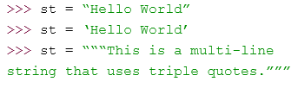
Sequence Types
• Tuples are defined using parentheses (and commas).
• Lists are defined using square brackets (and commas).
• Strings are defined using quotes (“, ‘, or “““).

Slide 7
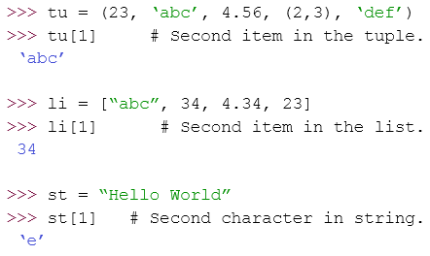
Sequence Types
• We can access individual members of a tuple, list, or string using square
bracket “array” notation.
• Note that all are 0 based…

Slide 8


Positive and negative indices
Positive index: count from the left, starting with 0.
Negative lookup: count from right, starting with –1.

Slide 9


Slicing: Return Copy of a Subset
Return a copy of the container with a subset of the original members. Start copying at the first index, and stop copying before the second index.
You can also use negative indices when slicing.

Slide 10


Slicing: Return Copy of a Subset
Omit the first index to make a copy starting from the beginning
of the container.
Omit the second index to make a copy starting at the first index
and going to the end of the container.

Slide 11

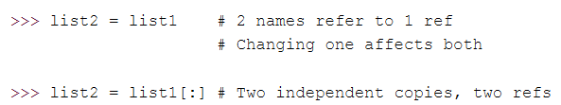
Copying the Whole Sequence
To make a copy of an entire sequence, you can use [:].
Note the difference between these two lines for mutable sequences:

Slide 12
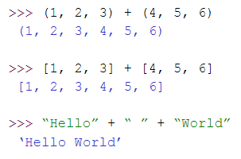
The + Operator
• The + operator produces a new tuple, list, or string whose value is the
concatenation of its arguments.

Slide 13
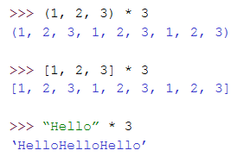
The * Operator
• The * operator produces a new tuple, list, or string that “repeats” the original content.

Slide 14
Mutability:
Tuples vs. Lists

Slide 15
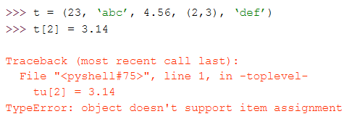
Tuples: Immutable
You can’t change a tuple.
You can make a fresh tuple and assign its reference to a previously used
name.

Slide 16
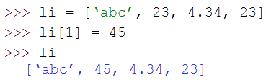
Lists: Mutable
• We can change lists in place.
• Name li still points to the same memory reference when we’re done.
• The mutability of lists means that they aren’t as fast as tuples.

Slide 17
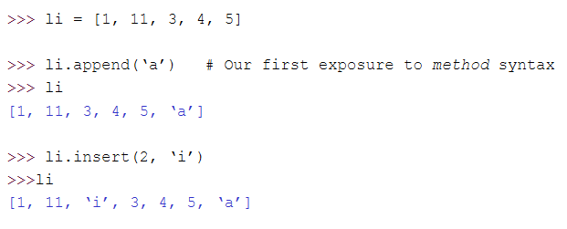
Operations on Lists Only

Slide 18


Operations on Lists Only
• + creates a fresh list (with a new memory reference)
• extend operates on list li in place.
• extend takes a list as an argument.
• append takes a singleton as an argument.

Slide 19
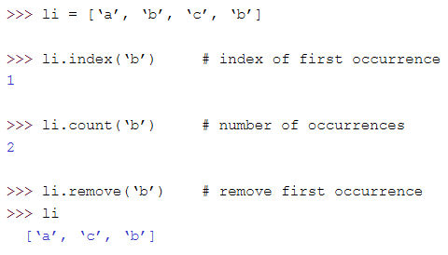
Operations on Lists Only

Slide 20
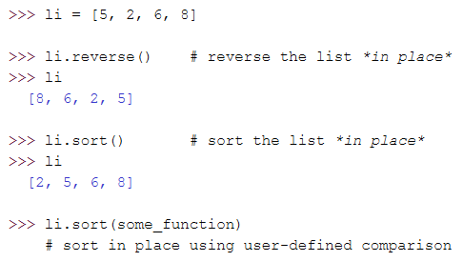
Operations on Lists Only

Slide 21
Tuples vs. Lists
• Lists slower but more powerful than tuples.
• Lists can be modified, and they have lots of handy operations
we can perform on them.
• Tuples are immutable and have fewer features.
• To convert between tuples and lists use the list() and tuple() functions:
li = list(tu)
tu = tuple(li)

Slide 22
Boolean Expressions

Slide 23
True and False
• True and False are constants in Python.
• Other values equivalent to True and False:
• False: zero, None, empty container or object
• True: non-zero numbers, non-empty objects
• Comparison operators: ==, !=, <, <=, etc.
• X and Y have same value: X == Y
• Compare with X is Y :
- X and Y are two variables that refer to the identical same object.
List comparators:
Li = [1, 2, ‘a’, 3, (‘hello’, 3.5)]
‘a’ in Li

Slide 24
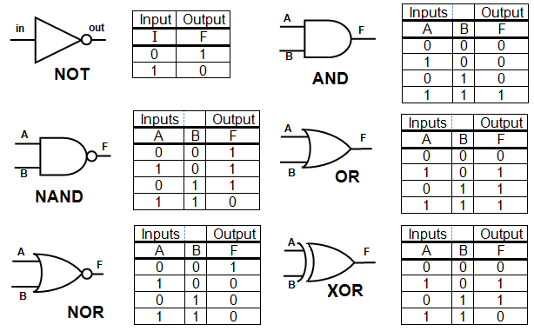
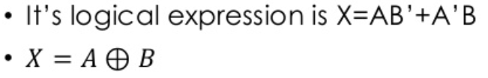
Logic Tables and Gates

Slide 25
Boolean Logic Expressions
• You can also combine Boolean expressions.
• true if a is true and b is true: a and b
• true if a is true or b is true: a or b
• true if a is false: not a
• Use parentheses as needed to disambiguate complex Boolean
expressions.

Slide 26
Special Properties of AND and OR
• Actually and and or don ’ t return True or False.
• They return the value of one of their sub-expressions (which may be a non-Boolean value).
• X and Y and Z
• If all are true, returns value of Z.
• Otherwise, returns value of first false sub-expression.
• X or Y or Z
• If all are false, returns value of Z.
• Otherwise, returns value of first true sub-expression.

Slide 27
Conditional Statements

Slide 28

If Statements: Basic structure
The keyword if starts the expression followed by a conditional comparison using any of the comparison operators: ==, !=, <, <=, etc.
The conditional statements can be used in conjunction with Boolean logic
A colon (:) after is used after the comparison expression
At least one statement must follow and it should be indented (if more than one statement is to be executed they will all need to have the same indentation)

Slide 29
Pseudocode
If the variable a less than 4 ?,
Print that the expression executed
If the variable a is equal to 7 and the variable b is greater or equal to 4,
Print that everything works

Slide 30
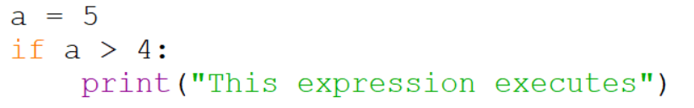


If Statements:

Slide 31
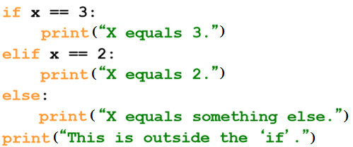
If Statements
Be careful! The keyword if is also used in the syntax of filtered list comprehensions.
Note:
• Use of indentation for blocks
• Colon (:) after Boolean expression

Slide 32
Resources
Matt Huenerfauth (Penn State)
Guido van Rossum (Google)
Richard P. Muller (Caltech)
Bill Boyd (Weslayan University)
Smithsonian Telescope Data Center
Programming Python, Mark Lutz
Fundamentals of Python, Kenneth Lambert

